Slide 1
A Comparison of Travel Behavior in SACOG and SANDAG
Shengyi Gao, Sacramento Area Council of Governments
Ziying Ouyang, San Diego Association of Governments
Notes:
RSG conducted a household travel survey for SANDAG in Fall, 2017 and SACOG in Spring, 2018 with the same survey instruments. These surveys included more information than national household travel survey by introducing rMove, a smartphone app. The motivation of this comparison is to know if there are substantial differences in travel between the two regions and if the differences can be attribute to demographics.

Slide 2
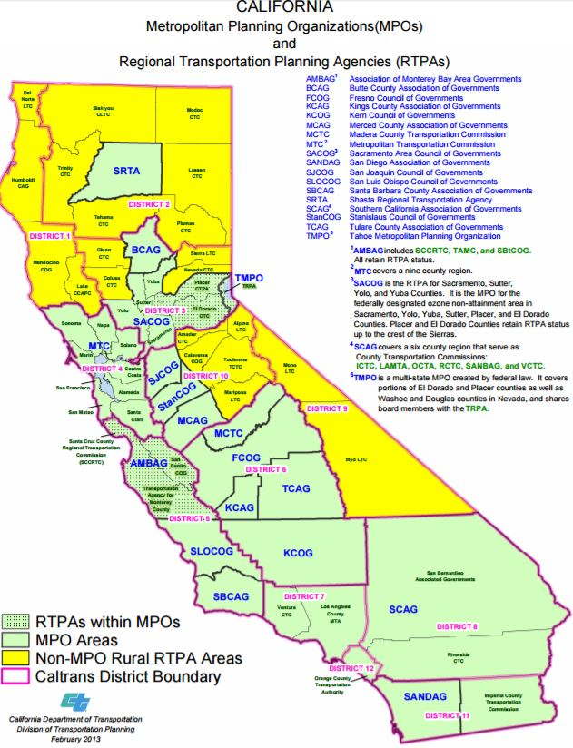
SACOG
Census Block Groups: 1,480
Population: 2,411,845
Households: 861,820
SANDAG
Census Block Groups: 1,795
Population: 3,223,096
Households: 1,094,157
Data from the 2011-2015 ACS
Notes:
Spatially, SACOG’s planning region covers 6 counties with about 2.4 million population in northern-central of California, while SANDAG is responsible for San Diego county on the south of the state, with about 3.2 million population.

Slide 3
Sample Rate
Notes:
The two MPOs have different sample segments and sampling rate. To SACOG, rural population is a big concern while to SANDAG, Hispanic population is a concern.
Both MPOs did a pilot study to estimate the sampling and response rate.
SANDAG oversample: Transportation oversample includes bicycle commuters (4x), walk or bike commuters (4x),transit commuters (4x),zero-vehicle households (4x); Hispanic oversample includes Hispanic ethnicity HHs (2.5x), Spanish-speaking HHs (2.5x), and low-income HHs (2.5x); Other oversample includes activity duty military (2x), college students (2x), young non-family HHs (2x);

Slide 4
Response Rate
SACOG
SANDAG
Sample segment | Number of invited | Number of completed | Response Rate | Response rate relative to regular sample | Relative response rate
General Population | 75,401 | 1,741 | 2.3% | 100.0% | 93.7%
Medium Walk/Bike/Transit | 28,010 | 693 | 2.5% | 107.2% | 100.4%
Rural | 19,519 | 321 | 1.6% | 71.2% | 66.7%
TNC or High Walk/Bike/Transit | 39,700 | 1,254 | 3.2% | 136.8% | 128.1%
Total | 162,630 | 4,009 | 2.5% | 106.8% | 100.0%
Sample segment | Number of invited | Number of completed | Response Rate | Response rate relative to regular sample | Relative response rate
General Population | 113,934 | 2,983 | 2.6% | 100.0% | 116.3%
Other oversample | 19,474 | 479 | 2.5% | 93.9% | 109.2%
Hispanic oversample | 38,785 | 495 | 1.3% | 48.7% | 56.7%
Transportation oversample | 103,070 | 2,242 | 2.2% | 83.1% | 96.6%
Total | 275,263 | 6,199 | 2.3% | 86.0% | 100.0%
Notes:
Overall, SACOG had a little higher response rate. Response rates various by sample segments. To get more accurate response rate and sample targets, pilot study is needed. SACOG’s response rate in final survey is very close to the one in pilot study.

Slide 5
Households by Household Size
Notes:
The sampled or responded (surveyed) ??? household size distribution in the two MPOs are substantially different.

Slide 6
Person Age of Participation Group
Notes:
In both regions, about 40% of all surveyed people are between 35 to 64 years old.
Age demographics vary by survey methods, rMOve is 7 days survey (Tuesday-Monday), and online is one-day diary (any day from Tuesday-Thursday)

Slide 7
Mode Share of Linked Person Trips (SACOG and SANDAG)
Notes:
Survey shows that there were less auto trips, but more walk trips in SACOG region.

Slide 8
Distribution of Household Vehicles (Weighted) by Participation Group
Notes:
Overall auto ownership distribution among participation group in two regions are very similar. But vary by survey methods - smartphone rMove App or Online Diary. In SANDAG, much more households with 2 vehicles used rMove App to recording the trips.

Slide 9
Household Vehicles by Fuel Type
Notes:
Survey shows that the majority of the vehicles are still using gasoline in both regions. Surprisingly, electric cars are not as many as we expected. You many notice that there are quite a lot vehicles using Flex fuel but too fewer hybrids in SANDAG region. We think there might be some misunderstanding about Flex Fuel definition in the survey.

Slide 10
Trip Distribution by Departure Time

Slide 11
Vehicle Miles Traveled
SACOG
SANDAG
Households | 860,726
Population | 2,229,793
Trips | 8,322,944
Vehicle Miles Traveled | 38,100,364
VMT Per Capita | 17.1
VMT Per Household | 44.3
VMT Distribution by MPG Category
EV | 0.8%
MPG > 30 | 14.5%
MPG 25-30 | 21.8%
MPG 20-25 | 32.9%
MPG 10-20 | 29.9%
Households | 1,113,624
Population | 2,922,537
Population for rates | 3,157,651
Trips | 11,665,894
VMT* | 48,179,138
VMT Per Capita | 15.3
VMT Per Household | 43.3
Data reported from ABM2 Calibration and Validation report. (VMT only includes resident travel, no median and heavy-heavy truck)

Slide 12
Takeaways
There are substantial differences in all travel related statistics.
There are substantial differences in demographics.
Besides the demographics, the urban form is thought to be an important factor that leads to the differences.

